Slide 1
Mathematics of Networks Review on Graphs
MA 653: Network Science
Instructor: Ashok Singh Sairam
ashok@iitg.ac.in

Slide 2
Representing networks
The network consists of entities connected with each other
The structure of these connections is represented through graphs
A graph is represented by two sets
A vertex set V of the entities participating in the network. Let n be the number of vertices
Also called node or actor set
An edge set E of the connections between vertices. Let m will be the number of edges
Also called link or tie set

Slide 3
Graph terminology
A graph whose vertices are connected by at most one link is called simple network or simple graph
Most of the graphs we will examine will be simple
When two nodes connect with more than one edge, we refer to all those edges collectively as multiedge
The corresponding graph is called multigraph
Depending on the type of connection a node might be connected to itself
Self-edges or self-loops

Slide 4
Representing graphs
If we label the nodes with IDs 1, 2, … n we can denote each edge as a pair (i,j)
This is an edge list specification
Good for storing and processing networks in computers, but not for mathematical development
The adjacency matrix A of a simple graph is a matrix with elements Aij such that:

Slide 5
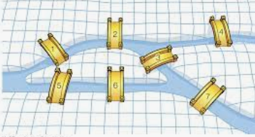
Representing Konigsberg bridges
Draw the corresponding graph
Represent the graph using adjacency matrix and adjacency list

Slide 6
Observations
The diagonal of the adjacency matrix is all 0 => No Self-Loops
How does self-loop affect the adjacency matrix? => A single self-edge from vertex i to itself is represented by setting the corresponding diagonal element Aii of the matrix equal to 2
The adjacency matrix is symmetric => It’s a undirected graph, or, a directed graph with edges such that if there is an edge between (i, j) then there is an edge between (j, i) as well.

Slide 7
Weighted networks
Some relations are not simple on/off (1/0) relations
In a weighted network links can have weights
The corresponding adjacency matrix entry is equal to the weight
Weights can represent the frequency of contacts between the actors, the capacity of a channel connecting two routers etc.
When weights are integer it might be convenient to think of the weight as multiedges

Slide 8
Directed networks
In some phenomena the direction of the underlying relation between two nodes matters → relations are not reciprocal
E.g., Twitter connections, world wide web links, paper citations etc.
These relations are captured through directed networks/graphs
The adjacency matrix of a directed graph (or a digraph) is given by:
A is in general not symmetric
Self edges are
represented by setting A_{ii}=1

Slide 9
Ex: Citation network
Paper 5 cites Paper 4 and Paper 3.
Paper 4 cites Paper 2.
Paper 3 cites Paper 2.
Paper 2 cites no other papers.
Paper 1 cites no other papers.

Slide 10
Directed Acyclic Graph/Networks
A cycle in a directed network is a closed loop of edges with the arrows on each of the edges pointing the same way around the loop
Networks without cycles are called acyclic, while those with cycles are called cyclic
Self-edges also count as cycles
An acyclic network can be drawn with all edges pointing downward (not necessarily a unique drawing)
Example: citation network
The vertical axis represents date of publication, point from
later to earlier paper

Slide 11
Directed Acyclic Graph/Networks
DAG construction
There must be at least one node (node I) with no outgoing edge (Proof ?)
Remove node I along with its edges (rename it as 1)
Repeat process – find another node with no outgoing edge, say node H, rename as 2
Finally, redraw the graph
edges from higher numbered to lower numbered only
B
A
C
D
E
F
G
I
H

Slide 12
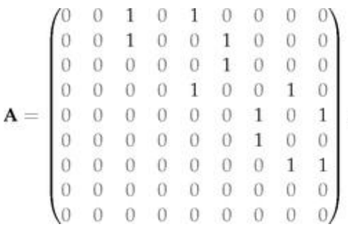
Directed Acyclic Network: construction
Draw adjacency matrix of the graph?
What property does the matrix have?=> Upper Triangular

Slide 13
Ex: DAG
Draw a directed acyclic network with all edges pointing downwards.
Write the adjacency matrix of the graph.
a/7
d
a
c/6
b/4
b
g
f/5
c
e
f
e/3
d/2
g/1

Slide 14
Acyclic network: adjacency matrix
If the nodes are numbered as described earlier, the adjaceny matrix has an interesting property
all non-zero elements lie above the diagonal
it is upper triangular
Diagonal elements are zero
Triangular matrix with zeros on the diagonal are called strictly triangular
All of the eigenvalues of an adjacency matrix are zero if and only if the network is acyclic
 | 7 | 6 | 5 | 4 | 3 | 2 | 1
7 | 0 | 1 | 0 | 1 | 0 | 0 | 0
6 | 0 | 0 | 1 | 0 | 0 | 0 | 0
5 | 0 | 0 | 0 | 0 | 1 | 0 | 1
4 | 0 | 0 | 0 | 0 | 1 | 1 | 0
3 | 0 | 0 | 0 | 0 | 0 | 0 | 1
2 | 0 | 0 | 0 | 0 | 0 | 0 | 1
1 | 0 | 0 | 0 | 0 | 0 | 0 | 0

Slide 15
Hypergraphs
Hypergraphs: Simple graph where an edge can connect more than two vertices
Vertex: Similar to conventional graph (person, gene, protein, etc.)
Hyperedge: An edge is called a hyperedge. A hyperedge can connect one or more vertices
Degree of a vertex: number of hyperedges to which it belongs
Application: Social networks, biology network
1
4
3
2
5

Slide 16
Representing hypergraph with bipartite graph
Introduce a new node corresponding to each group
There are 5 groups, so introduce 5 new nodes
1
4
3
2
5
1
2
3
4
5

Slide 17
Social Network Data: 1-mode
Social network data are substantively divided by the number of modes in the data
1-mode data represents edges based on direct contact between actors in the network.
All the nodes are of the same type (people, organization, ideas, etc).
Examples: Communication, friendship, giving orders, sending email.

Slide 18
Social Network Data: 2-mode
2-mode data represents nodes from two separate classes (actor & societies), where all ties are across classes.
Examples:
Actors as members of societies
Actors as authors on papers
Words used often by actors
Events in the life history of actors
The two modes of the data represent a duality:
One way to analyze two-mode data is to create projections onto each mode

Slide 19
Bipartite networks
In bipartite networks (two-mode networks) there are two kinds of vertices
One type represents the original vertices (e.g., people) and the other represents the groups – or affiliations or societies – that the first type of vertices belong to (e.g., company)
Edges of a bipartite network run only between nodes of different type
A bipartite network is defined by the incidence matrix B. If there are n number of actors and g number of groupsthen the incidence matrix B is a g × n matrix having elements Bij such that:

Slide 20
Ex: Working with two mode data (Persons)
What can you say about persons A & F? => No Common Group(as P16 = 0)
D & F? => 2 Common group (as P46 = 2)
Get the overlap for any pair of groups / persons
summing the multiplied elements of the corresponding rows/columns
Groups
1 2 3 4 5
A 0 0 0 0 1
B 1 0 0 0 0
C 1 1 0 0 0
D 0 1 1 1 1
E 0 0 1 0 0
F 0 0 1 1 0
Persons

Slide 21
Ex: Working with two mode data (Groups)
Similarly for groups
Similarly for Groups:
Groups
1 2 1•2
A 0 0 0
B 1 0 0
C 1 1 1
D 0 1 0
E 0 0 0
F 0 0 0
Σ 2 2 1
1 2 3 4 5
A 0 0 0 0 1
B 1 0 0 0 0
C 1 1 0 0 0
D 0 1 1 1 1
E 0 0 1 0 0
F 0 0 1 1 0
Group 1 has 2 members, group 2 has 2 members and they overlap by 1 members (C).
Persons

Slide 22
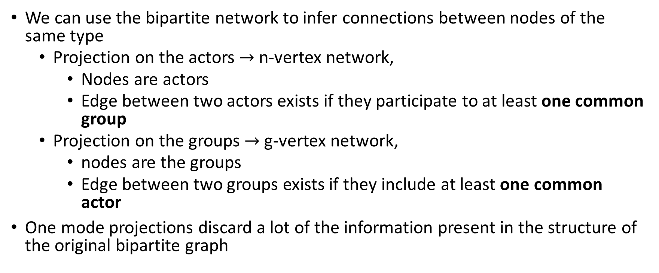
One-mode projections
We can use the bipartite network to infer connections between nodes of the same type
Projection on the actors $→$ n-vertex network,
Nodes are actors
Edge between two actors exists if they participate to at least one common group
Projection on the groups $→$ g-vertex network,
nodes are the groups
Edge between two groups exists if they include at least one common actor
One mode projections discard a lot of the information present in the structure of the original bipartite graph

Slide 23
Ex: One mode projection
Groups
Groups
1
2
3
4
5
1 2 3 4 5
A 0 0 0 0 1
B 1 0 0 0 0
C 1 1 0 0 0
D 0 1 1 1 1
E 0 0 1 0 0
F 0 0 1 1 0
Persons
A
B
C
D
E
F
Persons

Slide 24
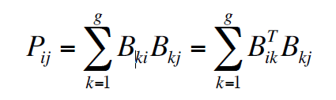
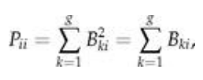
Mathematics of one-mode projection (1)
Two actors i and j belong to group k iff B_{ki}B_{kj}=1
The total number of groups P_{ij} that i and j belong is given by:
The n x n matrix P=B^{T}B is similar to the adjacency matrix for the weighted one-mode projection onto the n vertices
Why only similar and not the same? => P is not quite an adjacency matrix, however, since its diagonal elements are non-zero, even though the network itself, by definition, has no self-edges. (In this respect P is somewhat similar to the cocitation matrix of Section 6.4.1.) The diagonal elements have values,
where we have made use of the fact that Bki only takes the values 0 or 1. Thus Pii is equal to the number of groups to which vertex i belongs.

Slide 25
1 2 3 4 5
A 0 0 0 0 1
B 1 0 0 0 0
C 1 1 0 0 0
D 0 1 1 1 1
E 0 0 1 0 0
F 0 0 1 1 0
A B C D E F
1 0 1 1 0 0 0
2 0 0 1 1 0 0
3 0 0 0 1 1 1
4 0 0 0 1 0 1
5 1 0 0 1 0 0
A =
A^{T} =
(6x5)
(5x6)
P = A(A^{T})
G = A^{T}(A)

Slide 26
1 2 3 4 5
A 0 0 0 0 1
B 1 0 0 0 0
C 1 1 0 0 0
D 0 1 1 1 1
E 0 0 1 0 0
F 0 0 1 1 0
A B C D E F
1 0 1 1 0 0 0
2 0 0 1 1 0 0
3 0 0 0 1 1 1
4 0 0 0 1 0 1
5 1 0 0 1 0 0
A =
A^{T} =
(6x5)
(5x6)
P = A(A^{T})
G = A^{T}(A)
A * A^{T} = P
(6x5)(5x6) (6x6)
A^{T} * A = P
(5x6) 6x5) (5x5)
P
A B C D E F
A 1 0 0 1 0 0
B 0 1 1 0 0 0
C 0 1 2 1 0 0
D 1 0 1 4 1 2
E 0 0 0 1 1 1
F 0 0 0 2 1 2
G
1 2 3 4 5
1 2 1 0 0 0
2 1 2 1 1 1
3 0 1 3 2 1
4 0 1 2 2 1
5 0 1 1 1 2

Slide 27
Mathematics of one-mode projection
One can get either projection (person-to-person or group-to-group) easily with a little matrix multiplication
First define A^{T} as the transpose of A (simply reverse the rows and columns).
Person-to-person projection will be given by P= AA^{T}
Similarly, group-to-group project will be given by G= A^{T}A
The n x n matrix P=A^{T}A is similar to the adjacency matrix for the weighted one-mode projection onto the n vertices
Why only similar and not the same?

Slide 28
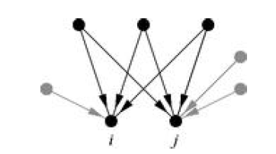
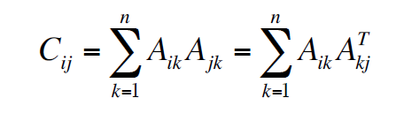

Co-citation coupling
The co-citation of two vertices i and j in a directed network is the number of nodes that have outgoing edges pointing to both nodes i and j
So in order for node k to contribute to the co-citation of i and j, the following needs to be true: A_{ik}A_{jk}=1
Hence the co-citation of nodes i and j is:
The n x n adjacency matrix of the corresponding co-citation network is:

Slide 29
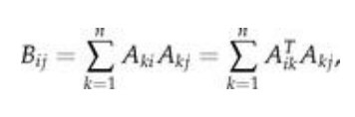

Bibliographic Coupling
The bibliographic coupling of two vertices in a directed network is the number of other vertices to which both point. In a citation network, for instance, the bibliographic coupling of two papers i and j is the number of other papers that are cited by both i and j.
Noting that A_{ki}A_{kj}=1 if i and j both cite k and zero otherwise, the bibliographic coupling of i and j is
and we define the bibliographic coupling matrix B to be the n × n matrix with elements Bij so that

Slide 30
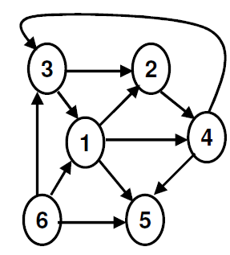
Example: Co-citation coupling

Slide 31
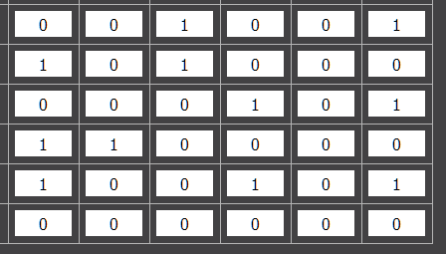
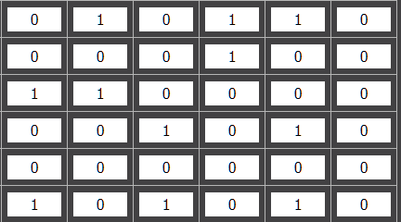
A =
A^{T} =
C = AA^{T}
 | 1 | 2 | 3 | 4 | 5 | 6
1 | 2 | 1 | 1 | 0 | 1 | 0
2 | 1 | 2 | 0 | 1 | 1 | 0
3 | 1 | 0 | 2 | 0 | 2 | 0
4 | 0 | 1 | 0 | 2 | 1 | 0
5 | 1 | 1 | 2 | 1 | 3 | 0
6 | 0 | 0 | 0 | 0 | 0 | 0

Slide 32
A =
A^{T} =
C = AA^{T}
 | 1 | 2 | 3 | 4 | 5 | 6
1 | 2 | 1 | 1 | 0 | 1 | 0
2 | 1 | 2 | 0 | 1 | 1 | 0
3 | 1 | 0 | 2 | 0 | 2 | 0
4 | 0 | 1 | 0 | 2 | 1 | 0
5 | 1 | 1 | 2 | 1 | 3 | 0
6 | 0 | 0 | 0 | 0 | 0 | 0

Slide 33
Problem 1
Consider certain papers and the references that they cite
1 →{2,4,5}
2 → {3,4,5}
3 →{4}
4 →{}
Which of these papers do you expect to be likely of similar topic?
Ans => 1 & 2, using Bibliographic Coupling

Slide 34
Problem 2
Consider a product website that maintains a purchase profile of the users over a time period T. A snap shot of the same for 4 users are as follows:
A → {1,2,3}
B → {1,3}
C → {1,2, 3, 4}
D →{ 3,4}
If A purchases an unknown product (say 5), can you say which other user will most likely purchase the same product?
Ans => C(?)

